Slide 1
第49回アジア・太平洋電気通信共同体（APT）管理委員会における
レセプション開催事務等請負
運営マニュアル
レセプション関連：スライド２～１０

Slide 2

EVENT OPERATION DECK
EVENT
DATE
VENUE
PAX
ITU Association of Japan for MIC Japan during MC-49 Reception
Wednesday, 10th December 2025
The Sala Thai Ballroom
130 people
EVENT AGENDA
Date | Time | Event | Venue | Set up | Min Att. | Price
Wednesday, 10th December 2025 | 08:00 onwards | Setup | The Sala Thai Ballroom, 5th Floor | Rounds |  | Minimum Spending @THB 350,000 net
Wednesday, 10th December 2025 | 18:00-22:00 | Dinner |  |  | 130
✓ Please kindly confirm dinner agenda
Please kindly confirm the final number of participants by 1 Dec 2025

Slide 3
式次第
17:45 レシービングライン(桐山国際戦略局次長、大鷹大使、堀川交渉官）
ドアオープン、ドリンクサービス開始（2時間フリーフロー）、
音楽・ビデオ開始
18:00 （長屋国際機関室室長によるキュー出し）（音楽・ビデオ停止）司会
挨拶 桐山国際戦略局次長（3分→近藤事務局長呼び込み）
  近藤事務局長（3分）（→桐山国際戦略局次長による堀川交渉官の紹介、呼び込み）
  堀川交渉官（3分）（→桐山国際戦略局次長による大鷹大使の呼び込み）
  大鷹大使（3分）
18:15 （音楽・ビデオ再開）司会
19:00 （長屋国際機関室室長によるキュー出し）司会

Slide 4
式次第（ホテル、スクリーン・音楽、司会部分）
16:30 Japanese host staff to check room layout i.e. stage, podium, microphone, table spacing, video & audio input/output.
17:15 Japanese dignitaries arrive and check speech position and microphone level
17:30~ Free flow of drinks starts as the first guest arrives
Music & Video start
17:45 Receiving line of 3 dignitaries at the entrance to Sala Thai ballroom
18:00 Food services standby,
(on cue) Music stops, Video changes to Slide
MC announce the start of the reception (MC1,2)
Speeches from host and guest dignitaries (4 speeches, 3 minutes each),
Slide page turned for each speaker
18:15 MC invites guests to enjoy food, drink and conversations (MC3)
Music & Video start
19:00 (on cue) Music & Video ends,
MC announce the closing of the reception (MC4)
19:30 free flow of drinks ends
21:30 Room cleared
MC1: Ladies and Gentlemen, Good evening and welcome to this reception hosted by the Government of Japan. We are honored to have you with us today and sincerely appreciate your presence despite your busy schedules.
MC2: To begin, I would like to invite our Director-General for International affairs, Mr. Nobuo Kiriyama, representing the Government of Japan, to deliver opening remarks.
MC3: Thank you very much. Please take this opportunity to enjoy the evening. We hope you will enjoy Sushi and Sake, Japanese rice wine, available at the buffet table and bar over there.
MC4: Ladies and Gentlemen, Thank you so much for joining us this evening at the Japan Reception. As we are now approaching the closing time, we would like to bring the reception to a close. Thank you again, and we wish you a pleasant evening.

Slide 5
DINNER ARRANGEMENT - FOOD
✓ Please advise which items to be change to Japanese item, our chef will get back for the menu.
✓For the menu please select and get back to us by 28 Nov, so our chef and work on menu and get back to you once again.
Together in this email, please find additonal live station list as attached for your consideration.
✓ Please kindly select either menu A or B from below:
MENU A
FRESH SALAD BAR
สลัดบาร์ และเครื่องคียง
THREE KINDS OF LETTUCE LEAF AND FIVE VEGETABLE CONDIMENTS
CAESAR, FRENCH, THOUSAND ISLAND, ITALIAN, BALSAMIC DRESSING,
PARMESAN CHEESE, CROUTONS, BLACK OLIVES, GREEN OLIVES, CORNICHONS,
FRESHLY BAKED BREAD, BUTTER, OILS AND VINEGARS
APPETIZER
สลัดมาสซาเรลล่ามะเขือเทศ – TOMATO MOZZARELLA, BALSAMIC AND BASIL (VE, GF)
สลัดฟูสิลี่เพสโต้ – PESTO FUSILLI PASTA SALAD, ZUCCHINI, PEA, PARMESAN (VE)
น้ำตกเนื้อ – GRILLED BEEF SALAD, TOASTED RICE, GROUND CHILI AND HERBS (DF)
ยำมะม่วงกุ้งสด – SOUR MANGO AND PRAWN SALAD, CASHEW NUT, SHALLOT, CHILI (DF, GF)
สะเต๊ะไก่ - CHICKEN SATAE, PICKLED CUCUMBER AND PEANUT CURRY SAUCE (DF, GF)
ขนมปังหน้าหมู – DEEP FRIED BREADED MINCED PORK, SWEET CUCUMBER DIP
SOUP
ต้มยำปลากะพง - SPICY AND SOUR BARRAMUNDI CLEAR SOUP, HOTBASIL (DF, GF)
ซุปมิสโตรเน่ – MINESTRONE PASTA SOUP, TOMATO, VEGGETABLES, PARMESAN (VE)
MAIN COURSE
แก้มเนื้อวัวตุ๋นซอสไวน์แดง - RED WINE BRAISED BEEF CHEEK, ONION AND POTATO (DF, GF)
แซลม่อนอบ ซอสเลมอนและผักชีลาว– ROASTED SALMON, LEMON DILL CREAM SAUCE (GF)
ไก่ย่างแบบพิริพิริ - GRILLED PIRI PIRI CHICKEN, CHILI, LEMON (GF)
พาสต้าอบชีสและซอสมะเขือเทศ – BAKED CONCHIGLIONI, CHEESE, TOMATO SAUCE (VE)
มัสมั่นแกะ – MUSSAMUN LAMB CURRY, PEANUT COCONUT AND ONION (LF, GF)
แกงเหลืองปลากะพง – FRIED BARRAMUNDI, SWEET CHILI SAUCE (DF)
หมูผัดพริกขิง – WOK FRIED RED CURRY PORK, LONG BEAN, KEFIR LIME (DF)
ข้าวสวย STEAMED JASMINE RICE (VG, GF)
DESSERT
ลอดช่องสิงคโปร์ (VG)
ICED SWEET DROPLETS OF PANDAN RICE FLOUR DUMPLING, COCONUT MILK AND PALM SUGAR SYRUP
ทิรามิสี TIRAMISU (VE)
ครีมพัฟใบเตย PANDAN CREAM PUFF (VE)
เค้กช็อคโกแลต CHOCOLATE CAKE, CHOCOLATE GLAZED (VE)
เค้กชาไทย THAI TEA CAKE (VE)
ขนมถ้วย COCONUT CUSTARD (VG, GF)
ขนมมัน STEAMED CASSAVA CAKE (VG, GF)
ผลไม้ตามฤดูกาล FRESHLY CUT TROPICAL FRUIT (VG, GF)
MENU B
FRESH SALAD BAR
สลัดบาร์ และเครื่องคียง
THREE KINDS OF LETTUCE LEAF AND FIVE VEGETABLE CONDIMENTS
CAESAR, FRENCH, THOUSAND ISLAND, ITALIAN, BALSAMIC DRESSING,
PARMESAN CHEESE, CROUTONS, BLACK OLIVES, GREEN OLIVES, CORNICHONS,
FRESHLY BAKED BREAD, BUTTER, OILS AND VINEGARS
APPETIZER
สลัดซีฟู๊ดเมดิเตอเรเนียน– MEDITERRANEAN SEAFOOD SALAD, SUNDRIED TOMATO, FETA, OLIVE (GF)
สลัดข้าวคีนัว - QUINOA SALAD, CORN, BELL PEPPERS, TOMATOES, ONIONS, CILANTRO, LIME (VG, GF)
ส้มตำไทย – SPICY PAPAYA SALAD, LONG BEAN, TOMATO, CRUSHED PEANUT AND DRIED SHRIMP (DF, GF)
น้ำตกเนื้อ – GRILLED BEEF SALAD, TOASTED RICE, GROUND CHILI AND HERBS (DF)
ไก่ห่อใบเตย – PANDANUS WRAP CHICKEN, CARAMELIZED SUGAR DIP (DF)
เก๊ยวกุ่ยช่ายทอด – DEEP FRIED GARLIC CHIVE, SWEET CHILI AND PEANUT DIP (VG, DF)
SOUP
ต้มแซ่บซี่โครงหมู – SOUR PORK RIB SOUP, ROASTED DRIED CHILI AND LOCAL PARSLEY (DF, GF)
ซุปครีมหอยลาย – CLAM CHOWDER
MAIN COURSE
สะโพกแกะอบวัลซ่าเวอร์เด้ – SLOW ROASTED LAMB RUMP, POTATO, SALSA VERDE (GF, DF)
ปลาแซลม่อนอบครีมซอส - BAKED SALMON, WHITE WINE CREAM SAUCE (GF)
อกไก่อบซอสเห็ด - ROASTED CHICKEN BREAST, MUSHROOM CHICKEN CREAM (GF)
มะเขือม่วงอบแบบพาร์มิเจียน่า – EGGPLANT PARMIGIANA (VE)
แพนงเนื้อ – RED CURRY BEEF BRISKET, PEANUT, KERFIR LIME (DF)
ปลากระพงทอดราดพริก – DEEP FRIED BARRAMUNDI, SWEET AND SOUR CHILI GLAZE (DF)
ถั่วหวานบล็อคคอลลี่ผัดกุ้ง – WOK FRIED BROCCOLI AND SNAP PEA, PRAWN (DF)
ข้าวสวย STEAMED JASMINE RICE (VG, GF)
DESSERT
ทับทิมกรอบ (VG, GF)
ICE RUBY CHESTNUT, COCONUT MILK SYRUP, JACKFRUIT
พายแอปเปิ้ล APPLE JALOUSIE (VE)
ช็อคโกแลตบราว์นี่ CHOCOLATE BROWNIE (VE)
ทิรามิสึชาเขียว GREEN TEA TIRAMISU (VE)
ชาไทยพานาคอตต้า CHOCOLATE PANNA COTTA (GF)
ทาร์มะม่วง MANGO TARTELETTE (VE)
ขนมกล้วย STEAMED BANANA CAKE (VG, GF)
ผลไม้ตามฤดูกาล FRESHLY CUT TROPICAL FRUIT (VG, GF)

Slide 6
DINNER ARRANGEMENT - FOOD
✓Please kindly select one Chef’s Kitchen from below list:
CHOOSE ONE OF CHEF’S KICTHEN MENU FROM BELOW LIST
CHEF’S KITCHEN
KAO NEAW GAI YAANG SOM TUM – ข้าวเหนียวไก่ย่าง หมูย่าง ส้มตำ (DF)
GRILLED LOCAL STYLE CHICKEN AND PORK SERVE WITH STICKY RICE AND PAYAYA SALAD
PHAD THAI GOONG – ผัดกุ้งสด (DF)
FRIED RICE NOODLES, PRAWN, TAMARIND SAUCE, GARLIC CHIVE AND BEAN SPROUTS
KHAO SOI NUA ข้าวซอยเนื้อ (DF)
NORTHERN BEEF CURRY CRISPY, CRISPY NOODLE, BEAN SPROUT, AND PICKLED CABBAGE
ITALIAN PASTA
THREE KINDS OF PASTA WITH PRAWN, BACON
WITH CHOICE OF CREAM, TOMATO, AGLIO E OLIO AND BOLOGNESE SAUCE
SPAGHETTI AL TARTUFO | VE
FRESH SPAGHETTI TOSSED IN TRUFFLE SAUCE AND FINISH IN A WHOLE GRANA PADANO WHEEL
MANGO STICKY RICE ข้าวเหนียวมะม่วง (VG, GF)
FRESH THAI MANGO SERVED WITH FRAGRANT SWEET COCONUT STICKY RICE

Slide 7
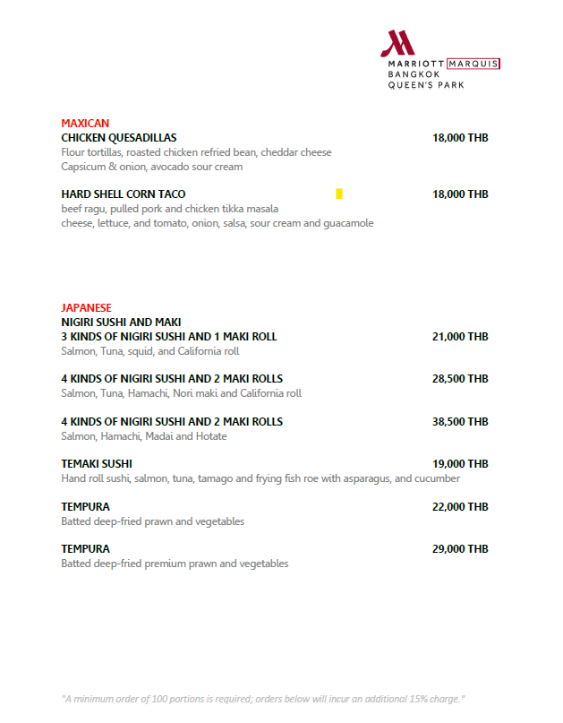
メニュー（Live Station：100人分、＋15％サービス料）
追加屋台
4 KINDS OF NIGIRI SUSHI AND 2 MAKI ROLLS 28,500 THB
TEMPURA（Batted deep-fried premium prawn and vegetables） 29,000 THB

Slide 8
DINNER ARRANGEMENT - BEVERAGE
Inclusive of free flow soft beverages
✓Confirmed Beverage Package C: 2 hours > 17.45-19.45 Hrs
Package | Inclusions | 1 Hour/Person | 2 Hours/Person | 3 Hours/Person | 4 Hours/Person
A | Soft drinks and juices | 300 net | 460 net | 590 net | 880 net
B | Chang Beer and soft drinks | 590 net | 880 net | 1,240 net | 1,470 net
C | Sommelier’s Choice Sommelier's choice of red and white wine, Chang beer and soft drinks | 1,100 net | 1,530 net | 1,770 net | 1,940 net
D | Bartender’s Choice Selection of house spirits selection (Chivas Regal 12 YO blended scotch whisky, Beefeater gin, Absolut vodka, Olmeca Gold tequila, Nusa Caña rum,) extended with Jack Daniels No. 7 Whisky, Chang Beer and soft drinks | 1,200 net | 1,600 net | 1,800 net | 2,100 net
Draught Beer (30 liters/Keg)
Chang Draught Beer: THB 11,500 net
Asahi Draught Beer: THB 12,500 net
San Miguel Draught Beer: THB 14,000 net
Heineken THB 15,000 net
Corkage charges:
THB 590 net per bottle of wine
THB 1,100 net per bottle of liqueur

Slide 9
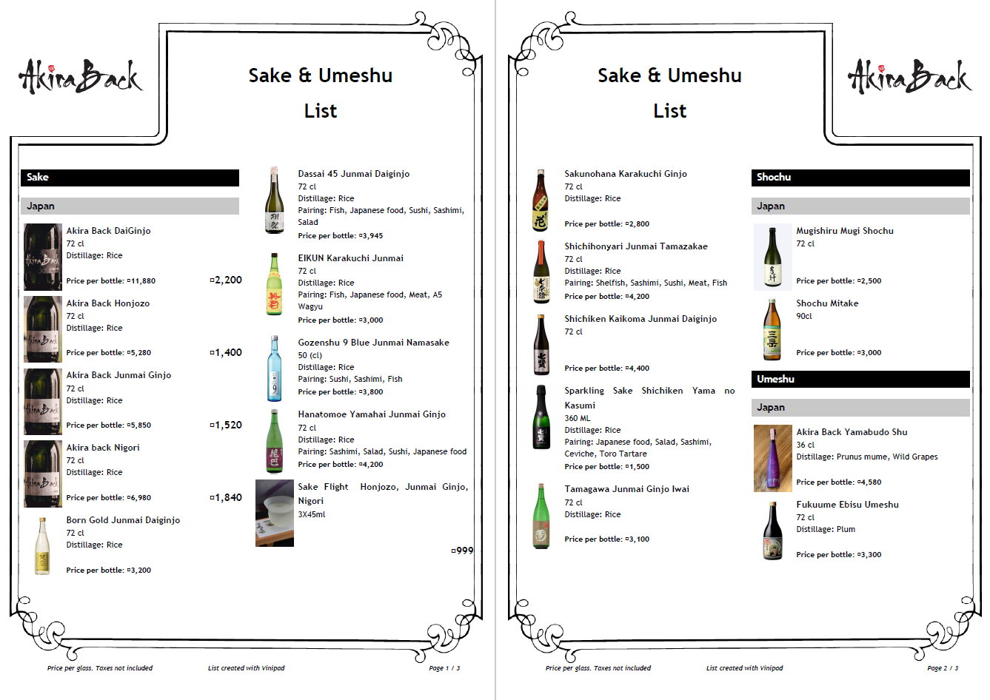
DINNER ARRANGEMENT - BEVERAGE
✓pre-order 7-10 days in advance.
Additional Sake & Umeshu
10 bottles
10 bottles

Slide 10
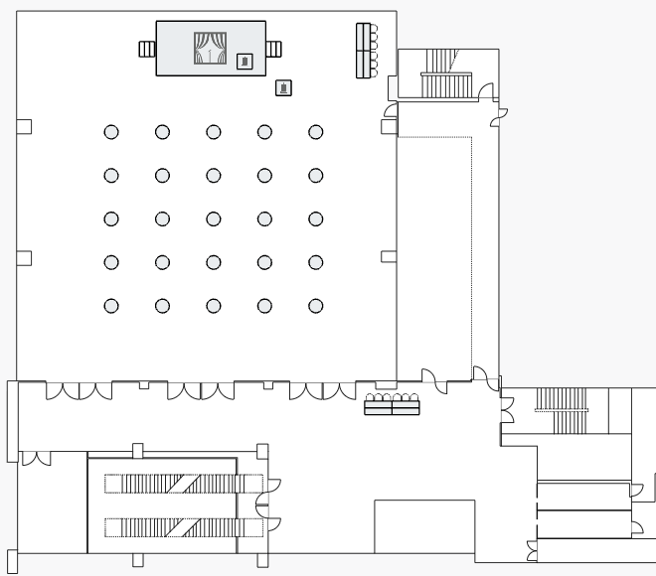
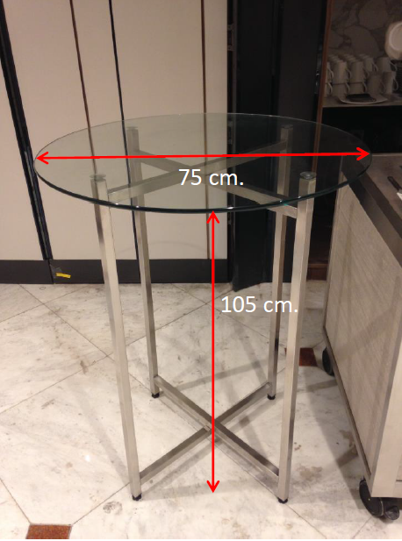
FLOOR PLAN
BQ Arrangement:
Registration desk at foyer
Stage size: 3.6 x 7.2 x 0.6 M
1 Podium on stage
1 Podium on floor for MC
Control table
25 x High cocktail table
AV Specifications:
Hotel provide HDMI / Audio line at Control table
04 x Wireless microphones
House light system
(Ballroom light – adjusted from 0-100%)
01 x LED screen
  Ratio full screen: 16:9
LED SCREEN
Podium
Control table
MC
BUFFET
BUFFET
BAR
BUFFET
▲定点ビデオカメラ
Registration Desk

Slide 11
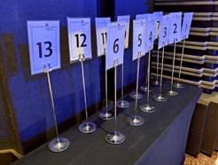
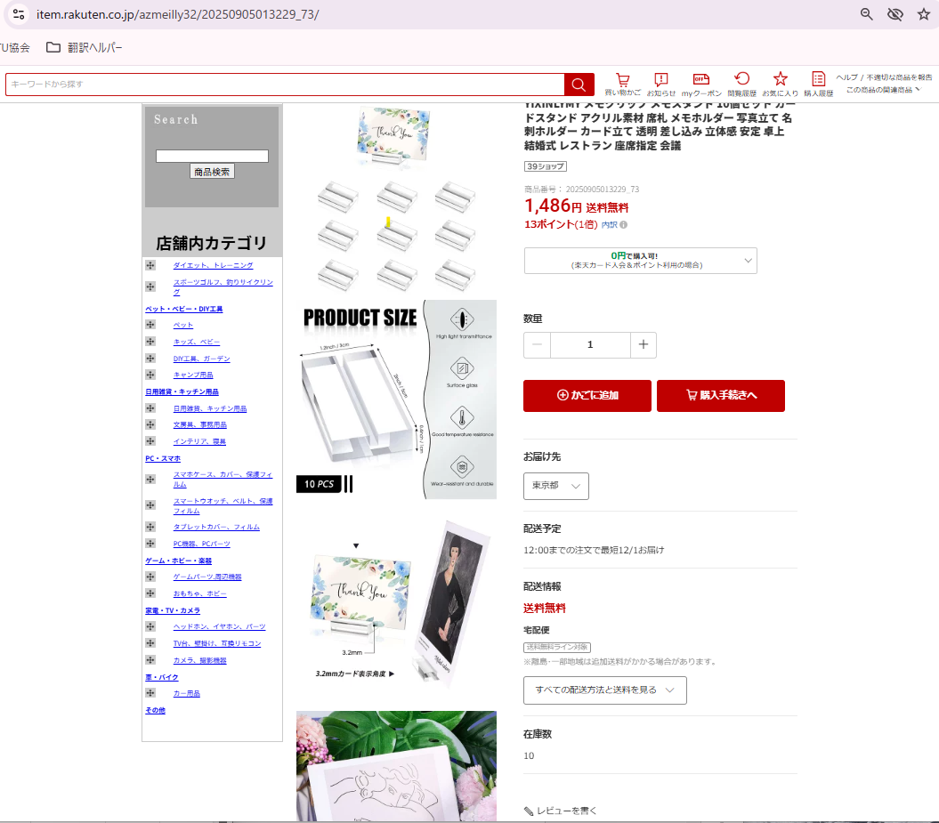
レセプションテーブル上のカードホルダーについて
ホテル用意の物は↑写真の通り。
カードのサイズとしてはホテル側からB5サイズを推奨されています。
これ以外のタイプをご希望でしたらお聞かせください。→右の物をイメージ（ITUAJにて購入）

Slide 12
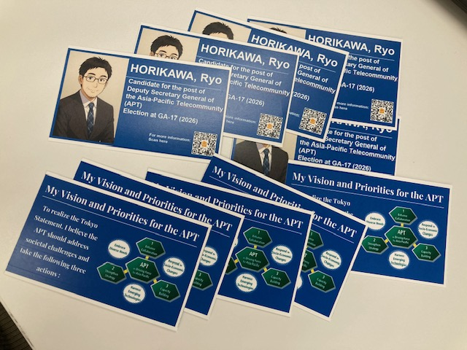
名刺大カード（両面カラー）を各テーブル上に置く
1枚はカード立てに、2枚は脇に置く
(25テーブル×3枚＝75枚）

Slide 13

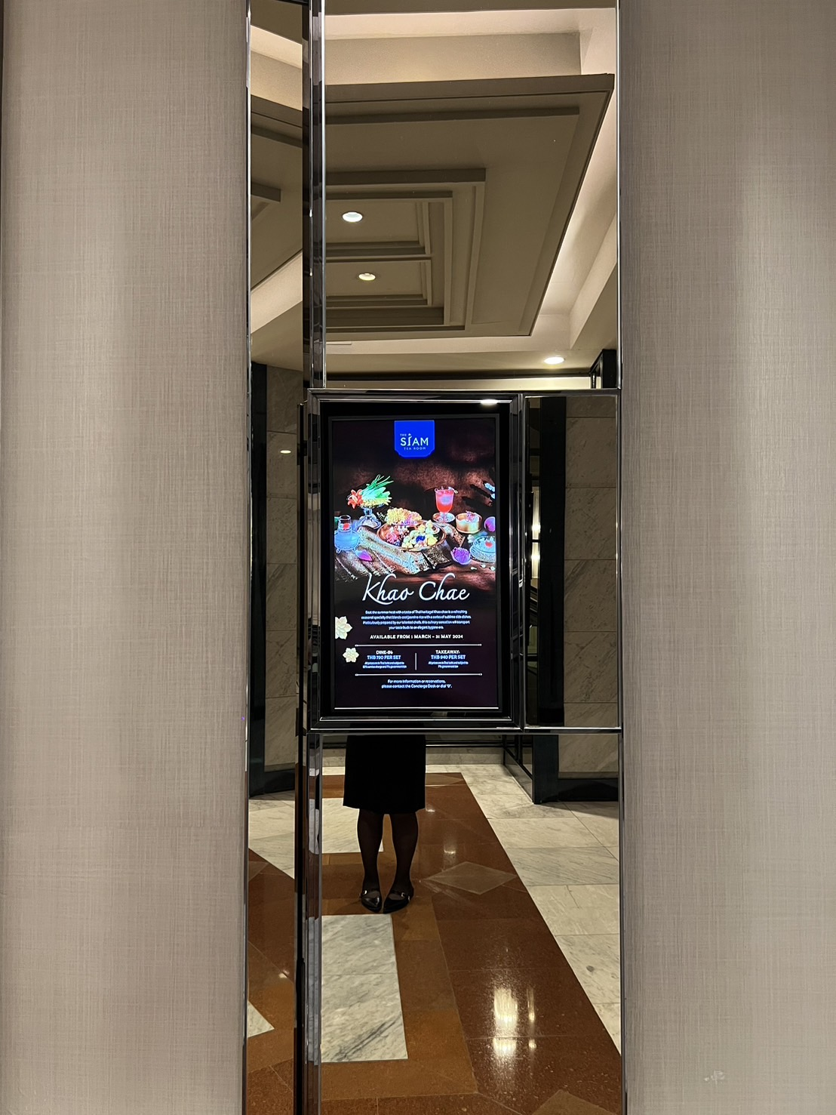


DIGITAL SIGNAGE SAMPLE
✓Please provide Company logo with event name – or please feel free to provide your own art work for digital signage in front of the Meeting Room
DIGITAL SIGNAGE IN FRONT OF MEETING ROOM
(ALL ROOMS ON LEVEL 2 / 3 / 4 / 5 / 7)
Portrait size 9:16 (1920 x 1080 resolution) JPEG / MP4 file format

